Slide 1
A new Language paradigm: diffusion Large Language Model
Fuliang Liu

Slide 2
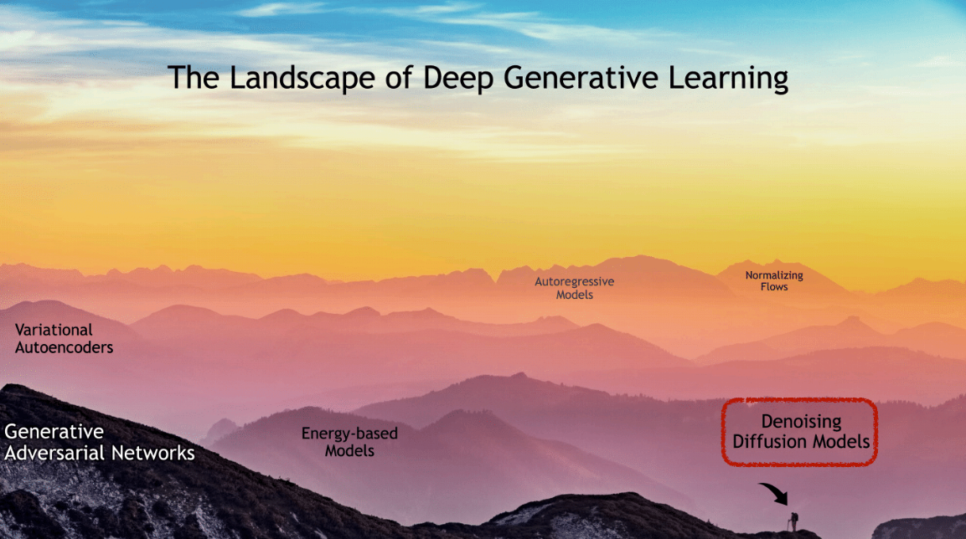
Presentation Outline
Introduction to diffusion
Deep generation models
Denoising score matching
Langevin MCMC
Annealed Langevin Dynamics
DDPM
Diffusion Language model research
SEDD: first dllm
LLADA series: scaling to 8B
Accelerate dllm with KV-cache
Interpolation of llm and dllm
Fast-dllm v2
SDAR series
Conclusion

Slide 3
Presentation Outline
Introduction to diffusion
Deep generation models
Denoising score matching
Langevin MCMC
Annealed Langevin Dynamics
DDPM
Diffusion Language model research
SEDD: first dllm
LLADA series: scaling to 8B
Accelerate dllm with KV-cache
Interpolation of llm and dllm
Fast-dllm v2
SDAR series
Conclusion

Slide 4
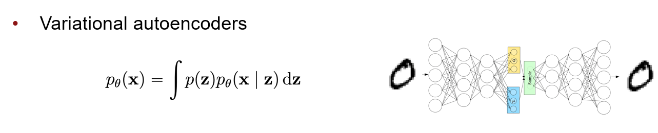
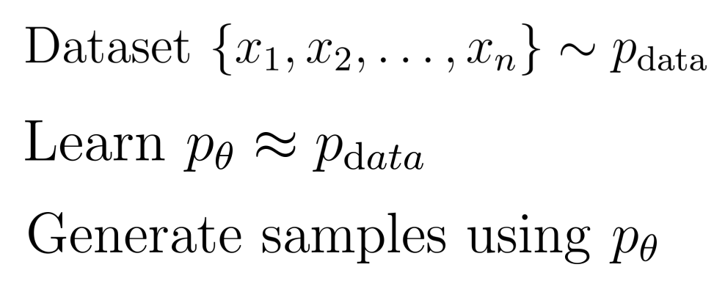
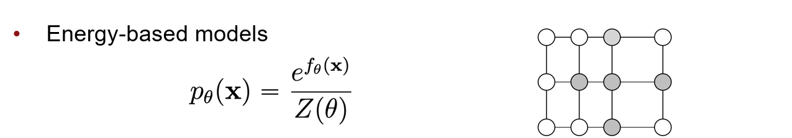
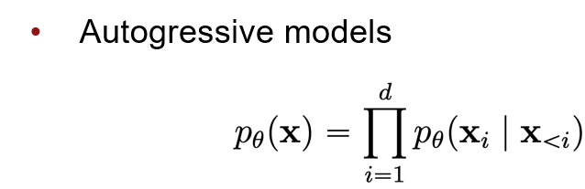
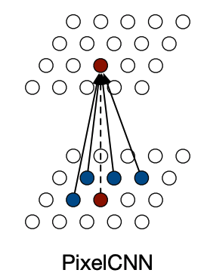
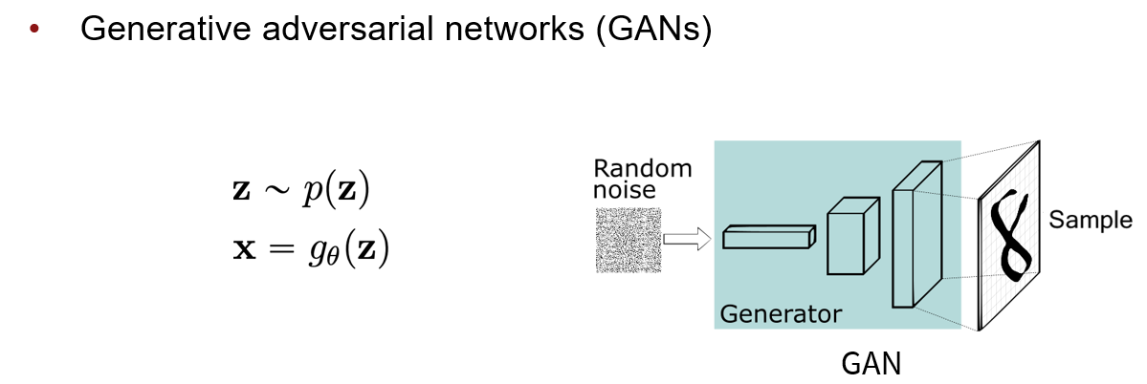
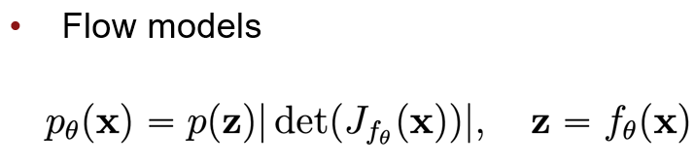
Deep Generative Models
CS236: Deep Generative Models Fall 2023 detailed syllabus
I Introduction to diffusion

Slide 5
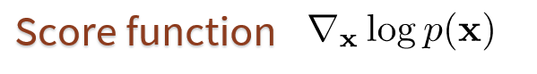
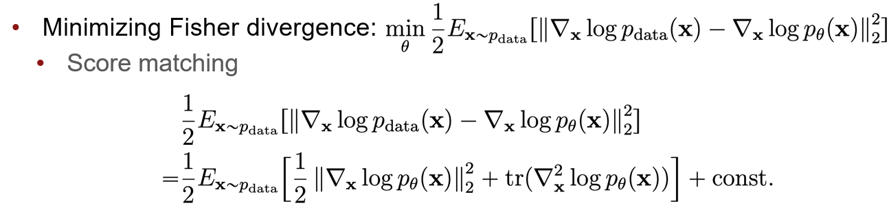
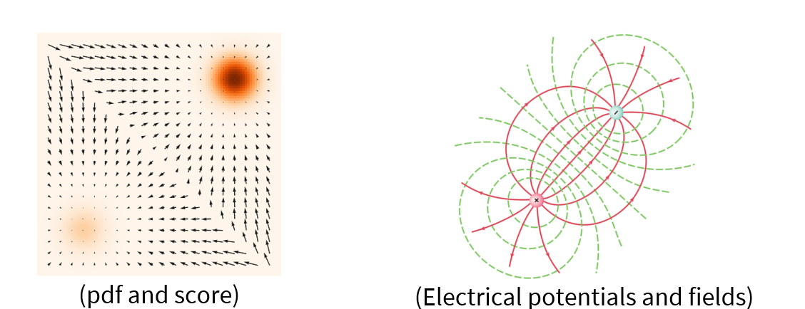
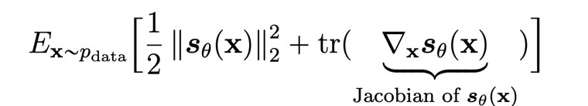
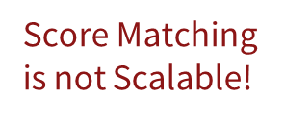
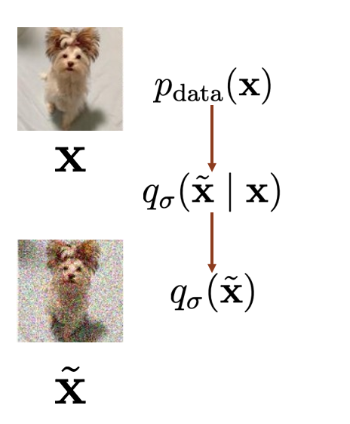
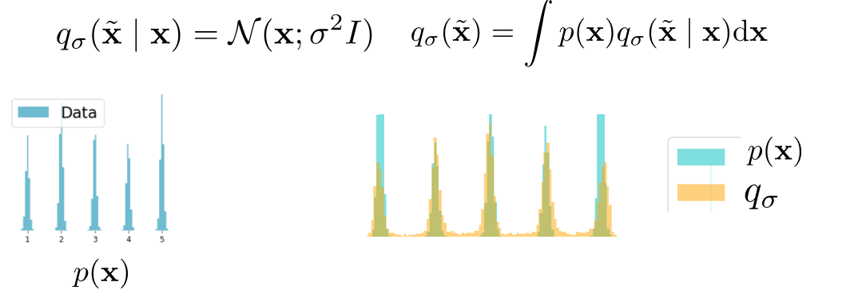
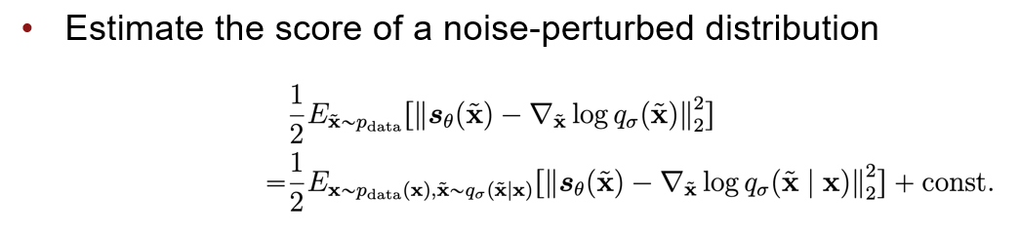
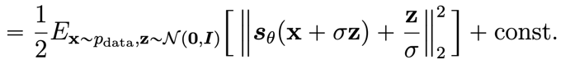
Diffusion Model – Denoising Score matching
CS236: Deep Generative Models Fall 2023 detailed syllabus
I Introduction to diffusion

Slide 6
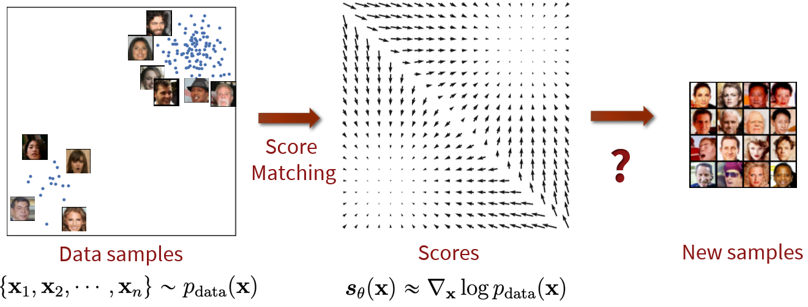
Diffusion Model – Score matching
CS236: Deep Generative Models Fall 2023 detailed syllabus
I Introduction to diffusion

Slide 7
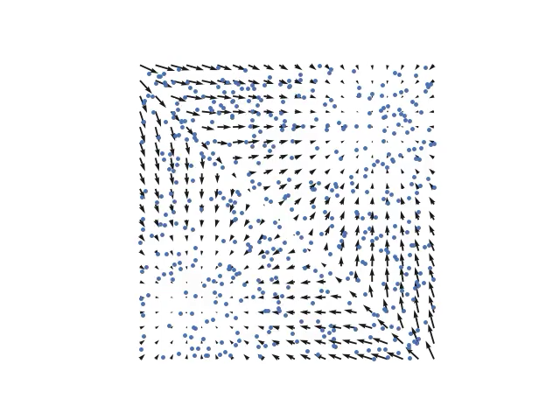
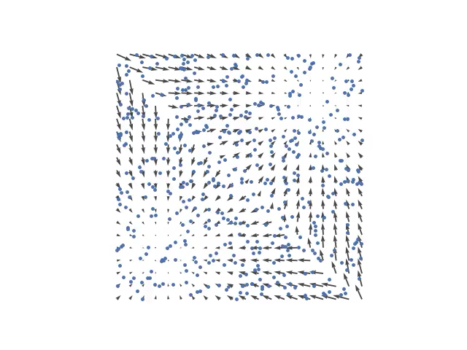
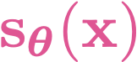
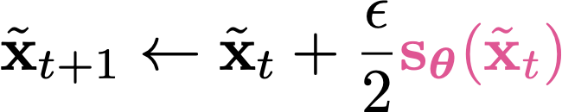
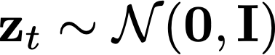
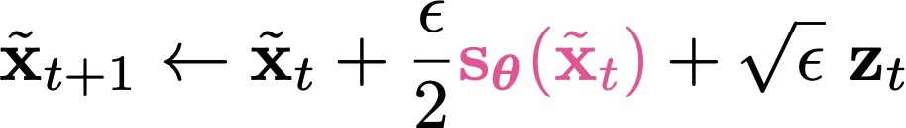
From scores to samples: Langevin MCMC
Scores
Follow the scores
Follow noisy scores:
Langevin MCMC
CS236: Deep Generative Models Fall 2023 detailed syllabus
I Introduction to diffusion

Slide 8
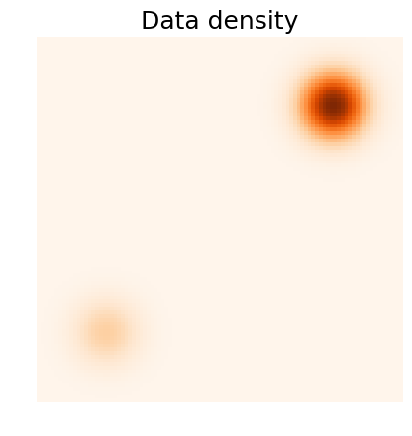
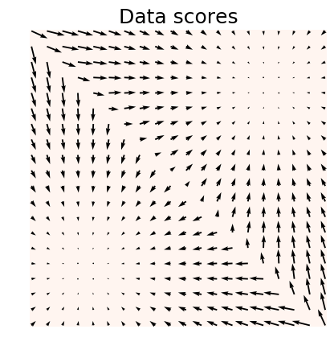
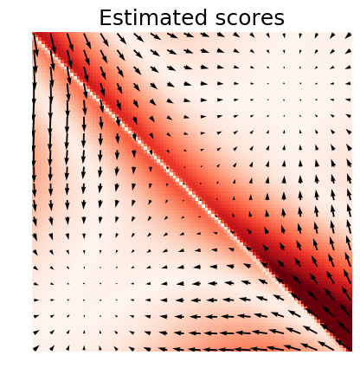
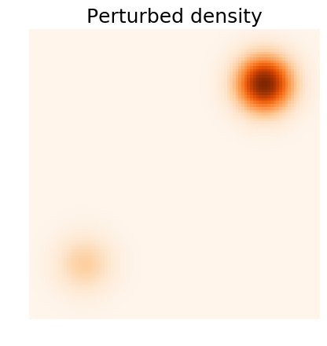
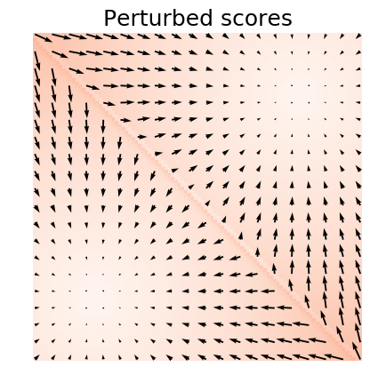
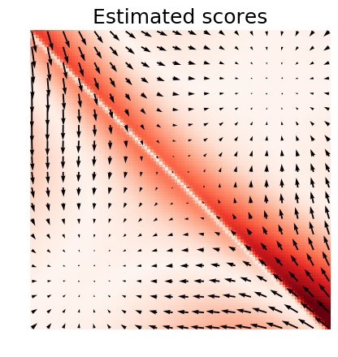
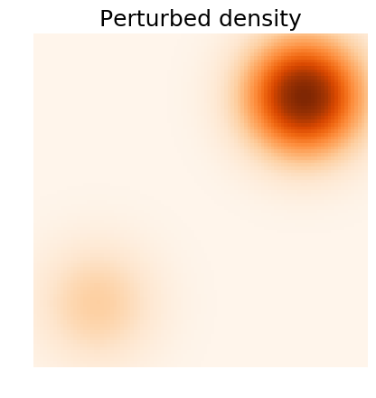
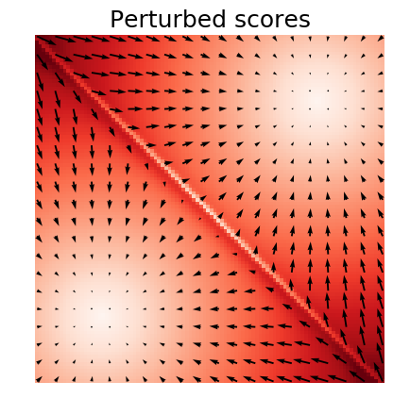
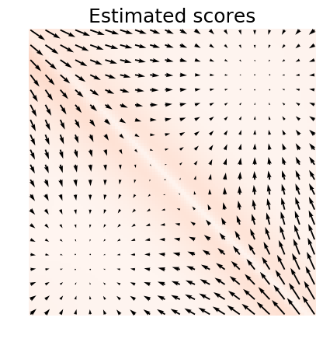
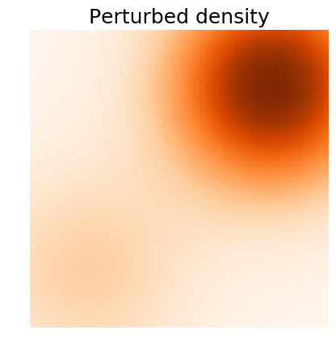
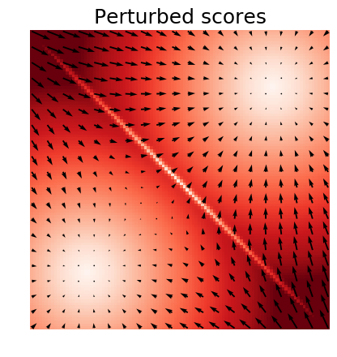
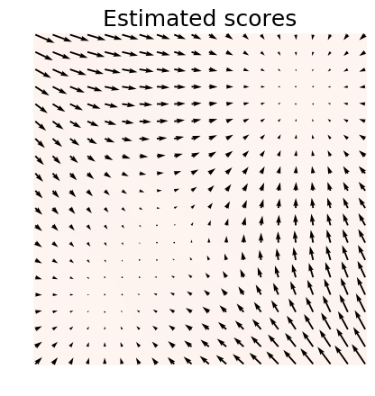
Trading off Data Quality and Estimation Accuracy && Multi-scale Noise Perturbation
Worse data quality!
Better score estimation!
CS236: Deep Generative Models Fall 2023 detailed syllabus
I Introduction to diffusion

Slide 9
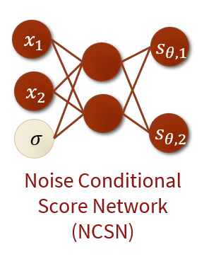
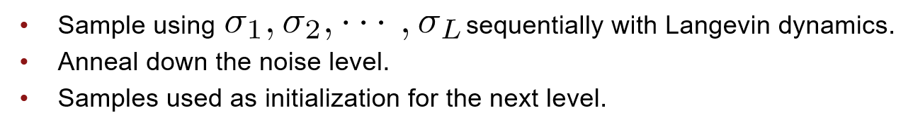
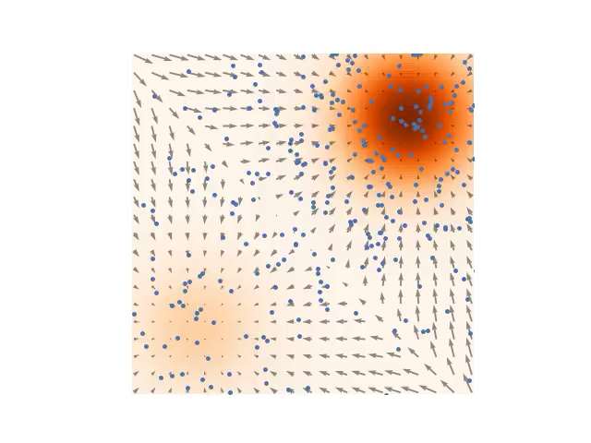
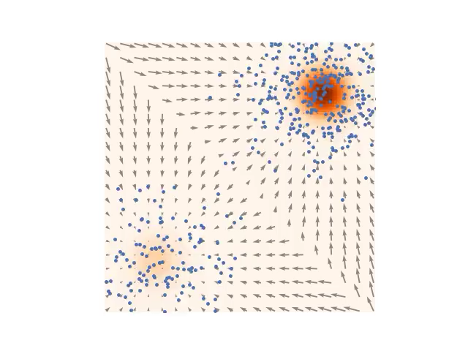
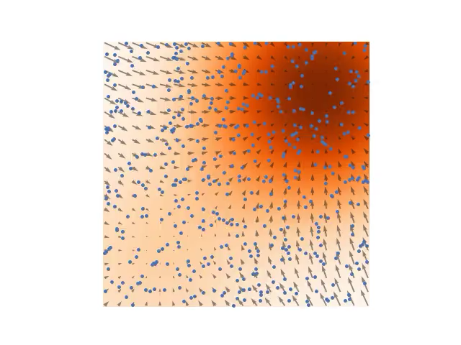
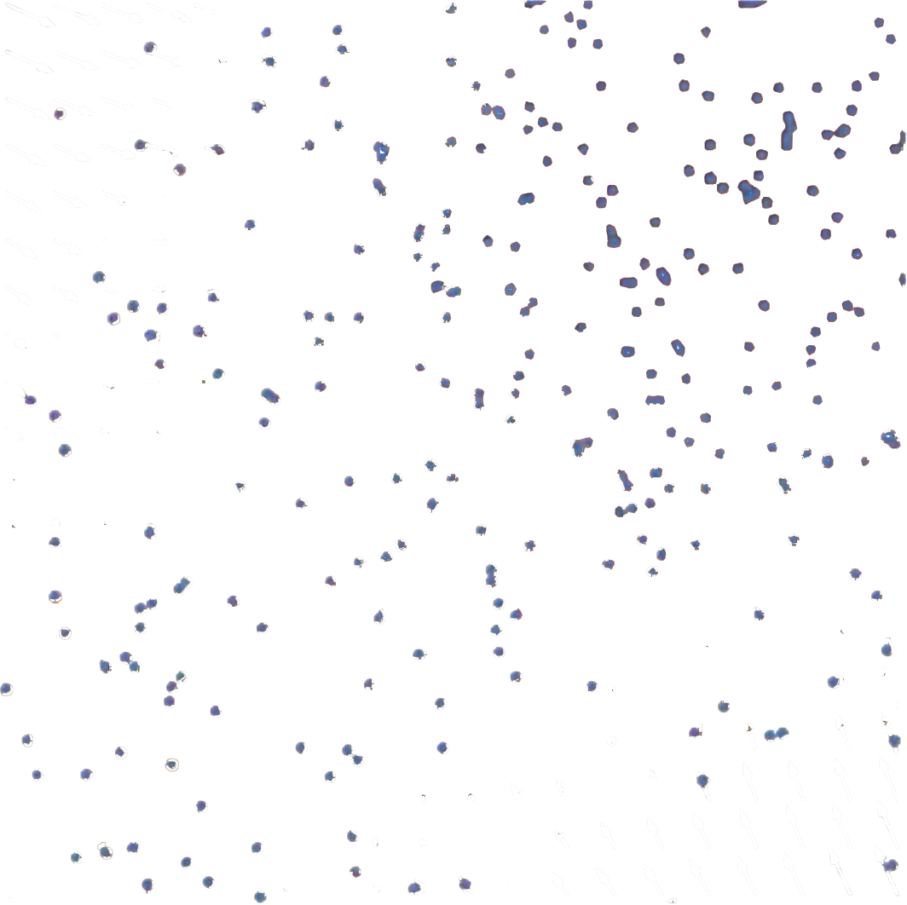
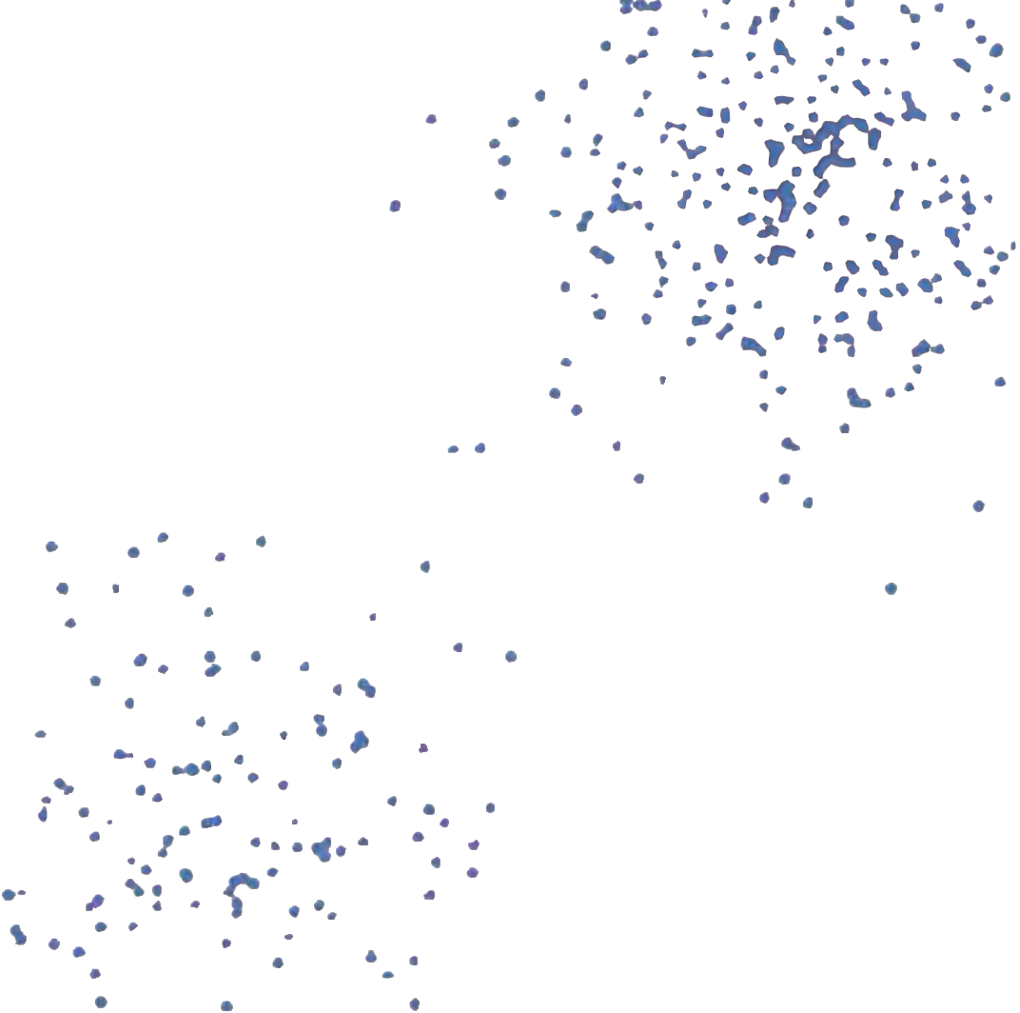
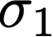
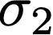
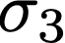
Multi-scale Noise Perturbation and Annealed Langevin Dynamics
CS236: Deep Generative Models Fall 2023 detailed syllabus
I Introduction to diffusion

Slide 10
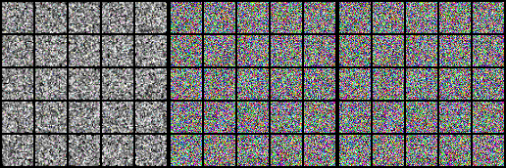
Experiments: Sampling
CS236: Deep Generative Models Fall 2023 detailed syllabus
I Introduction to diffusion

Slide 11
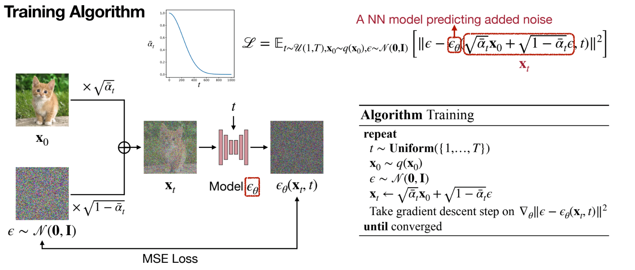
Denoising Diffusion Probabilistic Models (DDPM)
Denoising Diffusion Probabilistic Models, [Ho et al., NeurIPS 2020]
I Introduction to diffusion

Slide 12
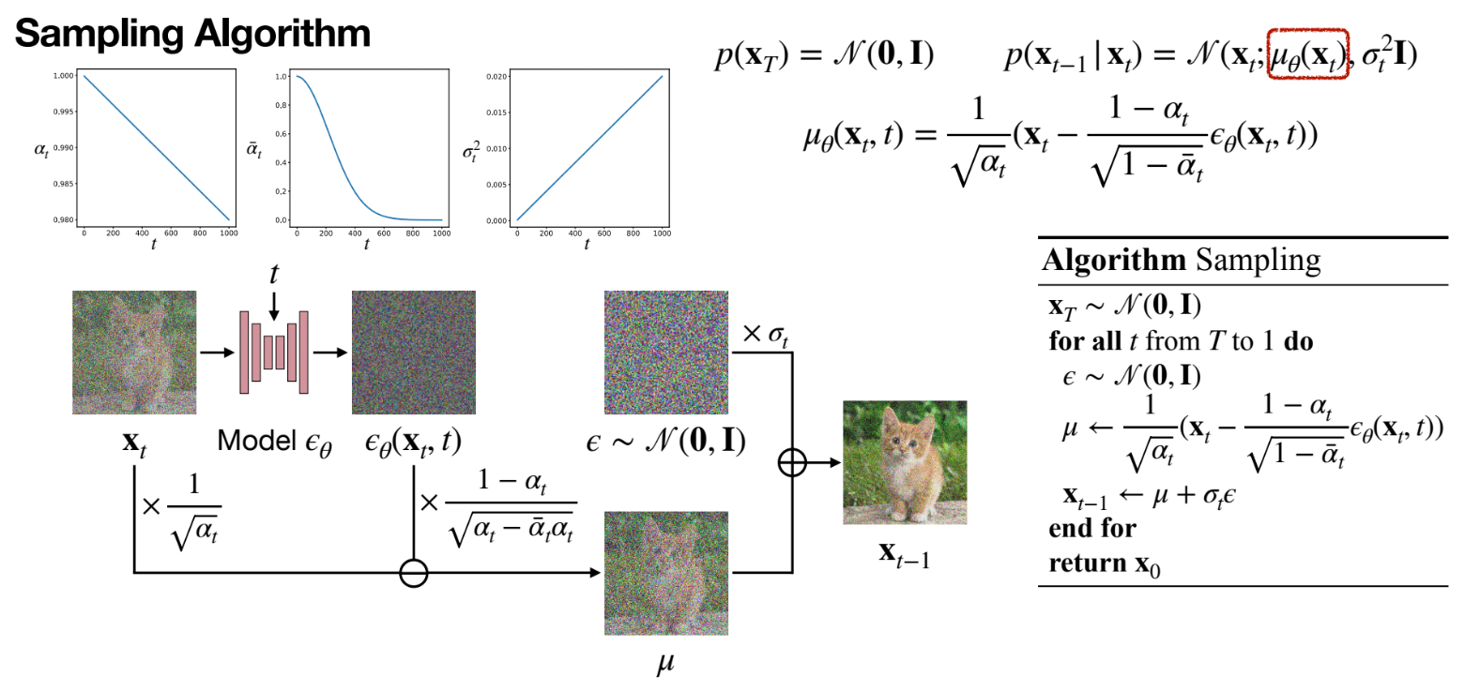
Denoising Diffusion Probabilistic Models (DDPM)
Denoising Diffusion Probabilistic Models, [Ho et al., NeurIPS 2020]
I Introduction to diffusion

Slide 13
Presentation Outline
Introduction to diffusion
Deep generation models
Denoising score matching
Langevin MCMC
Annealed Langevin Dynamics
DDPM
Diffusion Language model research
SEDD: first dllm
LLADA series: scaling to 8B
Accelerate dllm with KV-cache
Interpolation of llm and dllm
Fast-dllm v2
SDAR series
Conclusion
II dLLM research

Slide 14
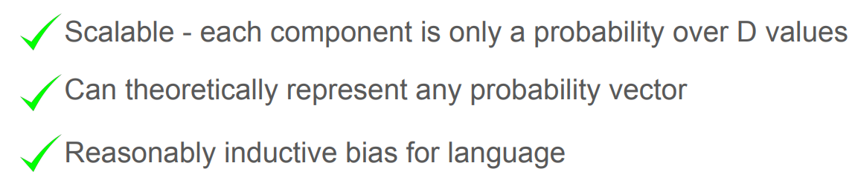


SOTA discrete generation: Autoregressive/AR Modeling
Introduction
Best Approach So Far for discrete data: Autoregressive/AR Modeling
Discrete Diffusion Modeling by Estimating the Ratios of the Data Distribution [Lou at ai., ICML 24 best paper]
II dLLM research

Slide 15



Diffusion for NLP?
No definition of score for tokens
Concrete Score:
Suitable for Transformer
Discrete Diffusion Modeling by Estimating the Ratios of the Data Distribution [Lou at ai., ICML 24 best paper]
II dLLM research

Slide 16




SEDD: loss function design
Discrete Diffusion Modeling by Estimating the Ratios of the Data Distribution [Lou at ai., ICML 24 best paper]
II dLLM research

Slide 17




SEDD: define Forward and Backward for diffusion
SOTA: absorb
Forward (clean to dirty)
2 types of Q
Discrete Diffusion Modeling by Estimating the Ratios of the Data Distribution [Lou at ai., ICML 24 best paper]
II dLLM research

Slide 18


SEDD: define Forward and Backward for diffusion
Backward (dirty to clean)
Discrete Diffusion Modeling by Estimating the Ratios of the Data Distribution [Lou at ai., ICML 24 best paper]
II dLLM research

Slide 19


SEDD: pseudocode for train and sample
Transformer with input t!
Not pure transformer like AR
(will later be fixed by RADD)
Discrete Diffusion Modeling by Estimating the Ratios of the Data Distribution [Lou at ai., ICML 24 best paper]
II dLLM research

Slide 20


SEDD: evaluation
Discrete Diffusion Modeling by Estimating the Ratios of the Data Distribution [Lou at ai., ICML 24 best paper]
II dLLM research

Slide 21



RADD: simplified SEDD
A key observation:
the concrete score at time t can be expressed as a time-independent conditional distribution at time zero multiplied by an analytic time-dependent term:
means we no longer need DiT(Transformer with input t)
Your Absorbing Discrete Diffusion Secretly Models the Conditional Distributions of Clean Data [Ou at ai., ICLR 25]
II dLLM research

Slide 22


RADD: simplified Loss function
RADD’s loss function:
easy
much like AR llm
SEDD’s loss function:
Complicate
Must take t as input
Your Absorbing Discrete Diffusion Secretly Models the Conditional Distributions of Clean Data [Ou at ai., ICLR 25]
II dLLM research

Slide 23


RADD: simplified sample method
Scaler var
Obtain from Transformer output
How to generate tokens form dirty to clean:
Your Absorbing Discrete Diffusion Secretly Models the Conditional Distributions of Clean Data [Ou at ai., ICLR 25]
II dLLM research

Slide 24

Recap: scaling-law for AR LLM
Scaling Law: for compute-optimal training, the model size and the number of training tokens should be scaled equally
Scaling up Masked Diffusion Models on Text [Nie at ai., ICLR 25]
II dLLM research

Slide 25

SMDM: scaling-law for dllm
dllm demonstrates a scaling rate comparable to autoregressive models(AR)
Scaling up Masked Diffusion Models on Text [Nie at ai., ICLR 25]
II dLLM research

Slide 26

SMDM: scaling-law for dllm
Some observations:
To get same Loss: MDM needs ×16 larger FLOPs (Major obstacles for nowadays dllm!)
Given same FLOPs: MDM needs ×0.5 model size
Scaling up Masked Diffusion Models on Text [Nie at ai., ICLR 25]
II dLLM research

Slide 27


LLADA: first 8B dllm
Outperform AR LLM in <=8B scale
Large Language Diffusion Models [Nie at ai., arxiv]
II dLLM research

Slide 28


LLADA: first 8B dllm
Same stages as AR: Pre-train/SFT/Sample
Semi-autoregressive sample
Large Language Diffusion Models [Nie at ai., arxiv]
II dLLM research

Slide 29

Diffusion’s CFG train and sample
An Introduction to Flow Matching and Diffusion Models[Holderrieth at ai., arxiv]
II dLLM research

Slide 30



LLADA’s CFG sampling
No special config for training stage, dllm already trains condition/uncondition generation
Only need modify sample
Need occupy 2 positions in BatchSize per inference
LLADA-MOE A1B 7B Huggingface source code
II dLLM research

Slide 31

FAST-DLLM : enforced KV-Cache
Up to ×27 speedup
Fast-dLLM: Training-free Acceleration of Diffusion LLM by Enabling KV Cache and Parallel Decoding[Wu at ai., arxiv]
II dLLM research

Slide 32



FAST-DLLM : enforced KV-Cache
Enforced use of KV-Cache:
Use wrong KV value for prefix and suffix tokens
But with small error, because KV-values near steps are very similar
After completing the decoding of a block, we update the cache for all tokens(not just the newly generated ones)
Fast-dLLM: Training-free Acceleration of Diffusion LLM by Enabling KV Cache and Parallel Decoding[Wu at ai., arxiv]
II dLLM research

Slide 33


FAST-DLLM : Confidence-Aware Parallel Decoding
Parallel decode tokens as much as possible
Fast-dLLM: Training-free Acceleration of Diffusion LLM by Enabling KV Cache and Parallel Decoding[Wu at ai., arxiv]
II dLLM research

Slide 34

FAST-DLLM : Evaluation
Fast-dLLM: Training-free Acceleration of Diffusion LLM by Enabling KV Cache and Parallel Decoding[Wu at ai., arxiv]
II dLLM research

Slide 35
Presentation Outline
Introduction to diffusion
Deep generation models
Denoising score matching
Langevin MCMC
Annealed Langevin Dynamics
DDPM
Diffusion Language model research
SEDD: first dllm
LLADA series: scaling to 8B
Accelerate dllm with KV-cache
Interpolation of llm and dllm
Fast-dllm v2
SDAR series
Conclusion
III Block-AR dLLM

Slide 36

FAST-DLLM V2: Efficient Block-Diffusion LLM
From AR-LLM well-trained weights: fine-tuning into a dllm in only 1B tokens
achieves up to 2.5× speedup over standard AR decoding while maintaining comparable generation quality.
This represents a 500× reduction in training data compared to full-attention diffusion LLMs such as Dream (580B tokens)
FAST-DLLM V2: Efficient Block-Diffusion LLM [Wu at ai., arxiv]
III Block-AR dLLM

Slide 37


FAST-DLLM V2: Training Process
complementary masking strategy
Token shift for prediction
Training objective:
FAST-DLLM V2: Efficient Block-Diffusion LLM [Wu at ai., arxiv]
III Block-AR dLLM

Slide 38

FAST-DLLM V2: Block-wise Attention Masking.
Train all blocks in 1 forward instead of B times
Due to the complementary mask:
the total number of tokens contributing to the loss for any given sample x0 is always the full sequence length L
FAST-DLLM V2: Efficient Block-Diffusion LLM [Wu at ai., arxiv]
III Block-AR dLLM

Slide 39


FAST-DLLM V2: Inference Process
Preceding blocks’ KV in KV-cache
Within current inference block:
Use fastdllm-v1 trick
Based on sub-block
FAST-DLLM V2: Efficient Block-Diffusion LLM [Wu at ai., arxiv]
III Block-AR dLLM

Slide 40

SDAR: A Synergistic Diffusion-AutoRegression Paradigm for Scalable Sequence Generation
No token shift for prediction
~50B fine-tuning data(vs ~1B in fastdllm-v2)
SDAR: A Synergistic Diffusion-AutoRegression Paradigm for Scalable Sequence Generation[Cheng at ai., arxiv]
III Block-AR dLLM

Slide 41

SDAR: Same Inference As Fastdllm-v2
SDAR: A Synergistic Diffusion-AutoRegression Paradigm for Scalable Sequence Generation[Cheng at ai., arxiv]
III Block-AR dLLM

Slide 42

SDAR: fundamental comparison between AR and MDLM
Train from scratch: 1T token pre-training, 4B token SFT, get 4 2B-model
Show below result:
First, AR > MDLM in same train config
Second, conversion strategy successfully preserves the strength of the AR
Third, MDLM-BD < AR-BD
Anyway, AR-BD performs best
SDAR: A Synergistic Diffusion-AutoRegression Paradigm for Scalable Sequence Generation[Cheng at ai., arxiv]
III Block-AR dLLM

Slide 43

SDAR: Scaling SDAR
Base models: Qwen3-1.7B, 4B, 8B, and 30B-A3B
Train with:
50B token CPT（Continued Pre-training）
4B token SFT（Supervised Fine-tuning）
Finally get: SDAR-Chat series (1.7B, 4B, 8B, 30B-A3B)
SDAR: A Synergistic Diffusion-AutoRegression Paradigm for Scalable Sequence Generation[Cheng at ai., arxiv]
III Block-AR dLLM

Slide 44

SDAR-Chat 30B-A3B Shows Less Sensitivity
larger models’ remarkable resilience:
Maintaining stable performance across a much wider range of block sizes.
Enable larger block sizes
τ ≥ 0.90: performance remains nearly saturated
SDAR: A Synergistic Diffusion-AutoRegression Paradigm for Scalable Sequence Generation[Cheng at ai., arxiv]
III Block-AR dLLM

Slide 45


SDAR-Chat 30B-A3B Shows High TPF
Larger models consistently achieve higher TPF
Reducing a model’s predictive entropy directly translate into greater decoding efficiency.
RL/distillation may bring better TPF
Bridge between Algr and Sys
SDAR: A Synergistic Diffusion-AutoRegression Paradigm for Scalable Sequence Generation[Cheng at ai., arxiv]
III Block-AR dLLM

Slide 46


Reasoning potential of SDAR
Base model: Qwen3-30B-A3B
Train with:
1T scientific corpus Extensive Domain Pre-training (AR Objective)
includes a 500B-token followed by a 500B-token annealing dataset.
50B Paradigm Conversion to SDAR
0.5B high-quality, long CoT instruction datasets
Get: SDAR-30B-A3B-Sci and AR-30B-A3B-Sci(same data but AR loss)
30B VS SOTA reasoning models like o3/gemini-2.5
SDAR: A Synergistic Diffusion-AutoRegression Paradigm for Scalable Sequence Generation[Cheng at ai., arxiv]
III Block-AR dLLM

Slide 47
Presentation Outline
Introduction to diffusion
Deep generation models
Denoising score matching
Langevin MCMC
Annealed Langevin Dynamics
DDPM
Diffusion Language model research
SEDD: first dllm
LLADA series: scaling to 8B
Accelerate dllm with KV-cache
Interpolation of llm and dllm
Fast-dllm v2
SDAR series
Conclusion

Slide 48
Conclusion
LLADA series dllm model:
models as a viable and promising alternative to ARMs, challenging the assumption that key LLM capabilities are inherently tied to ARMs.
Higher theoretical performance by bi-direction attention
A more comprehensive learning of data distribution from a global perspective
A new language modeling paradigm(e.g. Fast-dllm v2/SDAR) very promising for:
lightweight adaptation(1-50B data) that converts a well-trained AR model into a block-wise dllm
Vary-length generation instead of fix-content(dllm: LLADA/Dream)
Enable KV-Cache again
scales without compromise performence
exhibit increasingly higher parallel decoding efficiency.
strong reasoning and domain-specific capabilities
IV Conclusion

